Slide 1
JIT Frontend Bootcamp
Karol Kowalczuk, Łukasz Wiśniewski
January 2018

Slide 2
Agenda
JavaScript basics
Development tools
Introduction to react.js
React.js – (more) advanced concepts
App state management with redux
Advanced debugging techniques and testing*

Slide 3
JavaScript basics
1
JavaScript is a single-threaded scripting programming language.
OOP? Functional programming?
Why not both?!

Slide 4
JavaScript basics
2
Execution Environments
Web
Non-web
Both client- (interpreted compiled by browsers to CLR nowadays) and server-side (executed by node.js environment)
Embedded scripting language (e.g. browsers extensions)
General purpose scripting language
Used as an application platform
Notes:
Wypadałoby wspomnieć o V8 – zarówno Chrome jak i node.js korzystają z tego silnika. Implementuje specyfikację ECMAScript i kompiluje kod źródłowy skryptów do pośredniego języka maszynowego. Dba o alokacje pamięci, garbage collecting; wprowadza dodatkowe optymalizacje niemożliwe w przypadku podejścia interpretowanego.

Slide 5
JavaScript basics
3
OOP
Creating objects directly from other objects
Behaviour delegation
Composability
Extending objects dynamically
Tightly couples base class with inherited ones
Must know the desired properties of inherited object before instantiation
OLOO* („can do”)
Inheritance („is a”)
* objects-linked-to-other-objects
Notes:
“The problem with object-oriented languages is they’ve got all this implicit environment that they carry around with them. You wanted a banana but what you got was a gorilla holding the banana and the entire jungle.”
~Joe Armstrong

Slide 6
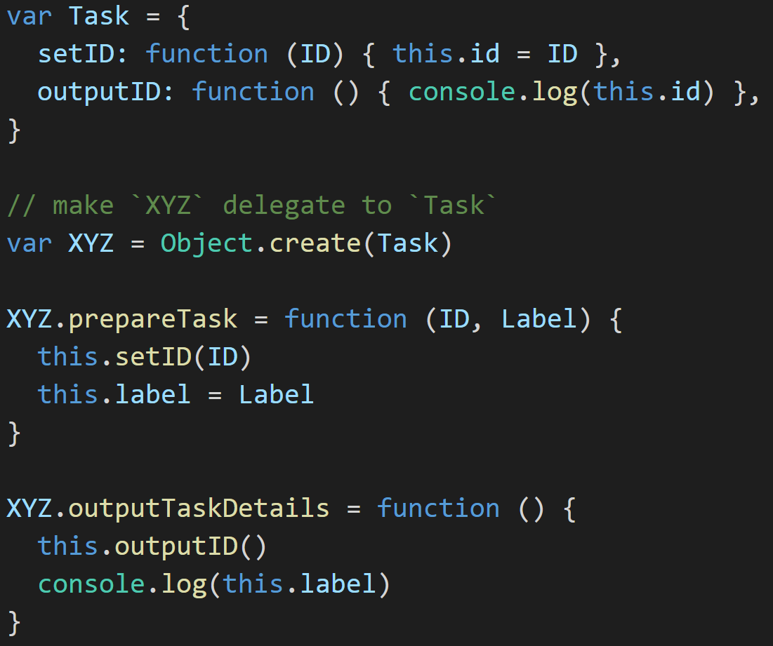
JavaScript basics
4
Behaviour delegation
Include a utility method if needed
Credits to: Kyle Simpson

Slide 7
JavaScript basics
5
Functional programming
Pure functions
No shared state
Given the same input always gives the same output; makes composition easy as pie
Do not pass the properties of the object between scopes
No state mutations
No side effects
Allows to track the transfomations and do time-traveling
Just be deterministic

Slide 8



JavaScript basics
6
Asynchronous calls
Wait, what?

Slide 9
JavaScript basics
7
one thread == one stack == one thing at a time
except not really.
Notes:
JS Runtime jest jedno-threadowy, ale nie zapominajmy że przeglądarka to nie tylko Runtime.

Slide 10
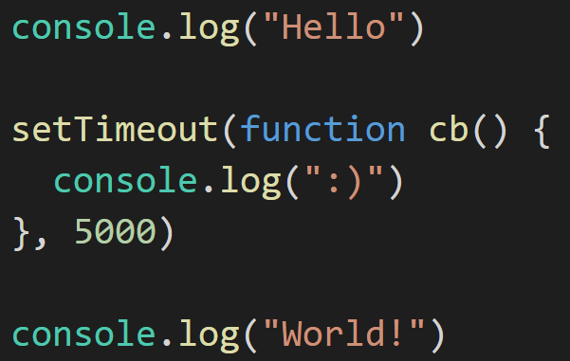

JavaScript basics
8
stack
threads (WebAPIs)
console
event loop
tasks queue

Slide 11
JavaScript basics
8
stack
threads (WebAPIs)
main()
console
event loop
tasks queue

Slide 12
JavaScript basics
8
stack
threads (WebAPIs)
log(“Hello”)
main()
console
Hello
event loop
tasks queue

Slide 13
JavaScript basics
8
stack
threads (WebAPIs)
main()
console
Hello
event loop
tasks queue

Slide 14
JavaScript basics
8
stack
threads (WebAPIs)
setTimeout(cb)
main()
console
Hello
event loop
tasks queue

Slide 15

JavaScript basics
8
stack
threads (WebAPIs)
timer
cb
setTimeout(cb)
main()
console
Hello
event loop
tasks queue

Slide 16
JavaScript basics
8
stack
threads (WebAPIs)
timer
cb
main()
console
Hello
event loop
tasks queue

Slide 17
JavaScript basics
8
stack
threads (WebAPIs)
timer
cb
log(“World”)
main()
console
Hello
World
event loop
tasks queue

Slide 18
JavaScript basics
8
stack
threads (WebAPIs)
timer
cb
main()
console
Hello
World
event loop
tasks queue

Slide 19
JavaScript basics
8
stack
threads (WebAPIs)
timer
cb
console
Hello
World
event loop
tasks queue

Slide 20
JavaScript basics
8
stack
threads (WebAPIs)
console
Hello
World
event loop
tasks queue
cb

Slide 21
JavaScript basics
8
stack
threads (WebAPIs)
cb
console
Hello
World
event loop
tasks queue
Notes:
Event loop – patrzy na stos, jak jest pusty, wrzuca na niego po kolei zadania z task queue

Slide 22
JavaScript basics
8
stack
threads (WebAPIs)
log(“:)”)
cb
console
Hello
World
:)
event loop
tasks queue
Notes:
Event loop – patrzy na stos, jak jest pusty, wrzuca na niego po kolei zadania z task queue

Slide 23
JavaScript basics
8
stack
threads (WebAPIs)
cb
console
Hello
World
:)
event loop
tasks queue
Notes:
Event loop – patrzy na stos, jak jest pusty, wrzuca na niego po kolei zadania z task queue

Slide 24
JavaScript basics
8
stack
threads (WebAPIs)
console
Hello
World
:)
event loop
tasks queue
Notes:
Event loop – patrzy na stos, jak jest pusty, wrzuca na niego po kolei zadania z task queue

Slide 25
JavaScript basics
9
XHR*
Promises
Fetch API
Since 1999
since 2012
Since 2015 (Chrome v40+)
Registering callbacks for particular events (onload, onerror)
Objects representing async actions result; there are three different states of Promises: fulfilled, rejected, pending
Wraps HTTP requests with a Promise; still not widely supported by browsers
* XMLHttpRequest
Notes:
At their most basic, promises are a bit like event listeners except:
A promise can only succeed or fail once. It cannot succeed or fail twice, neither can it switch from success to failure or vice versa.
If a promise has succeeded or failed and you later add a success/failure callback, the correct callback will be called, even though the event took place earlier.
Promises były implementowane przez twórców bibliotek, w standardzie języka są dopiero od standardu ES6 (2015), o którym zaraz

Slide 26
JavaScript basics
10
ECMAScript 2015
6th version of standardized scripting-language specification
Initially created to standardize JavaScript.

Slide 27
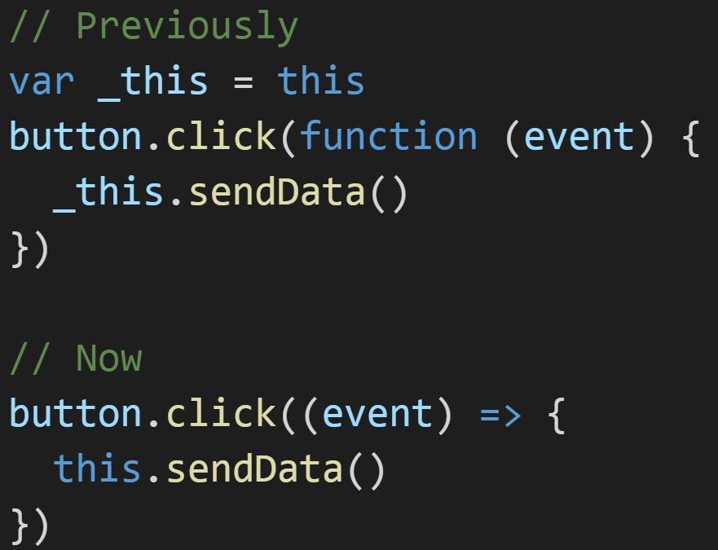
JavaScript basics
11
Arrow functions
No need to bind “this” anymore
Notes:
“this” refers to the owner of the function.

Slide 28
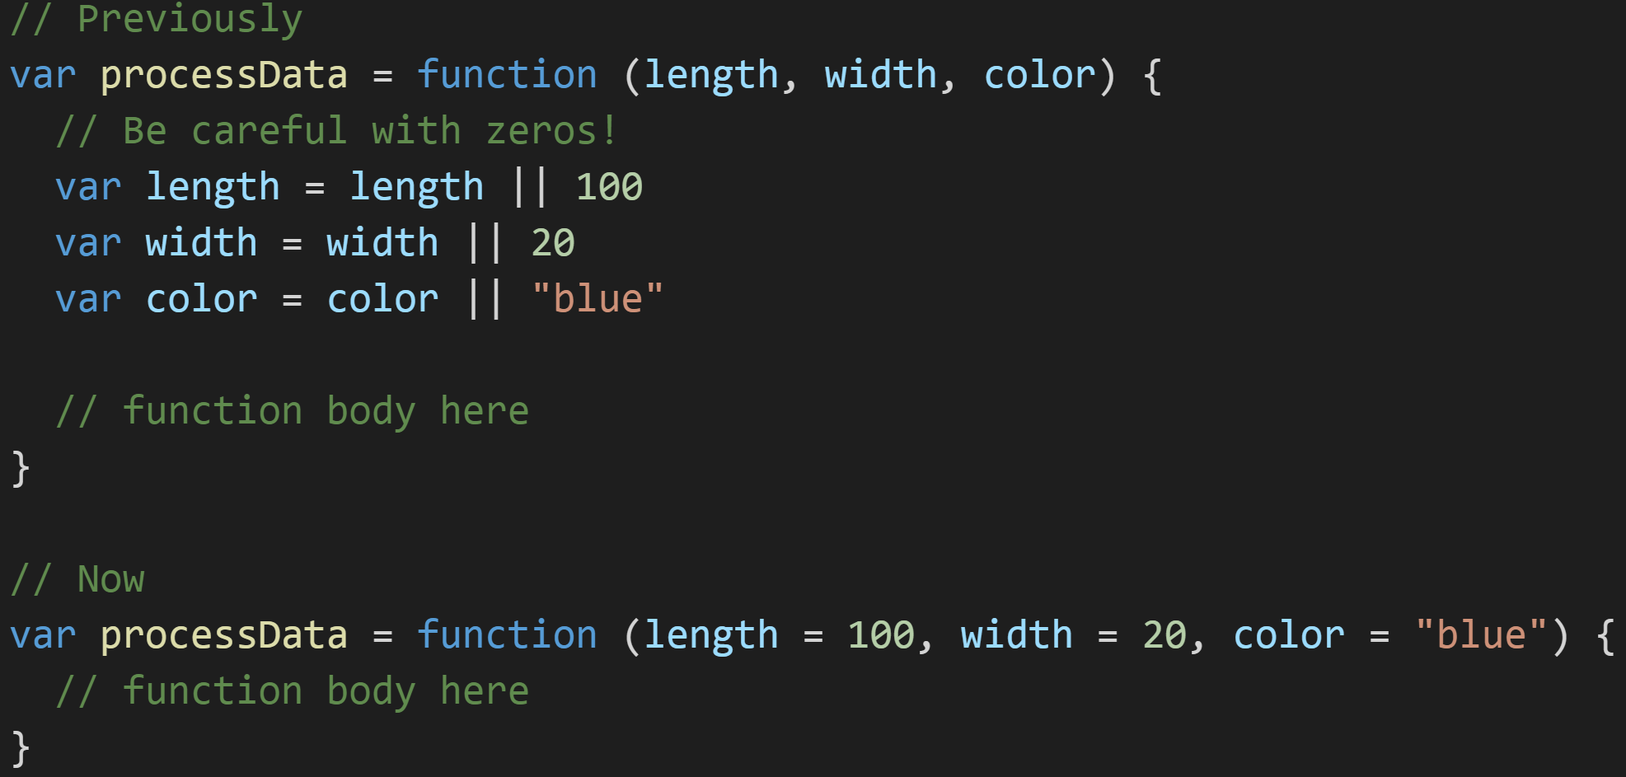
JavaScript basics
12
Default parameters
Get rid of “or” evaluations

Slide 29
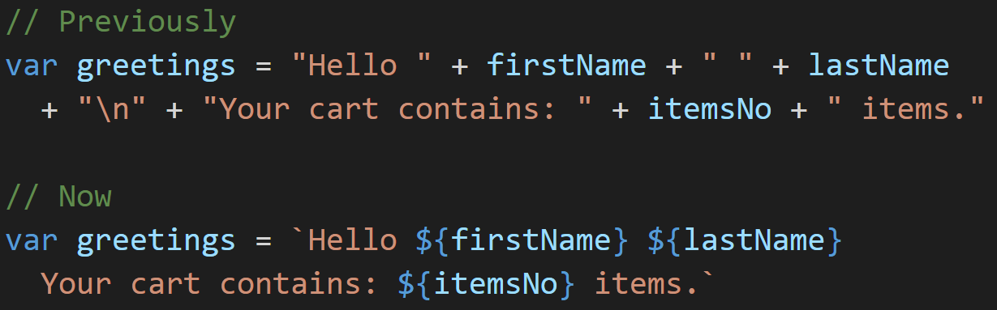
JavaScript basics
13
String literals
Put variables in a string directly
Notes:
“this” refers to the owner of the function.

Slide 30
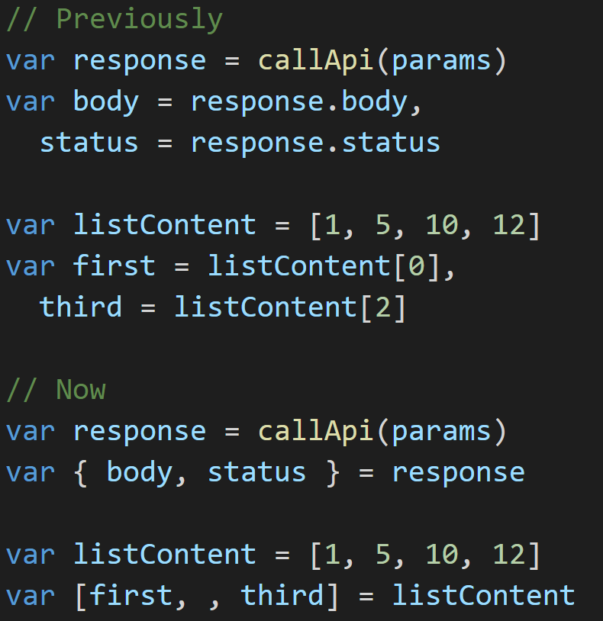
JavaScript basics
14
Destructuring assignment
It’s a kind of magic

Slide 31
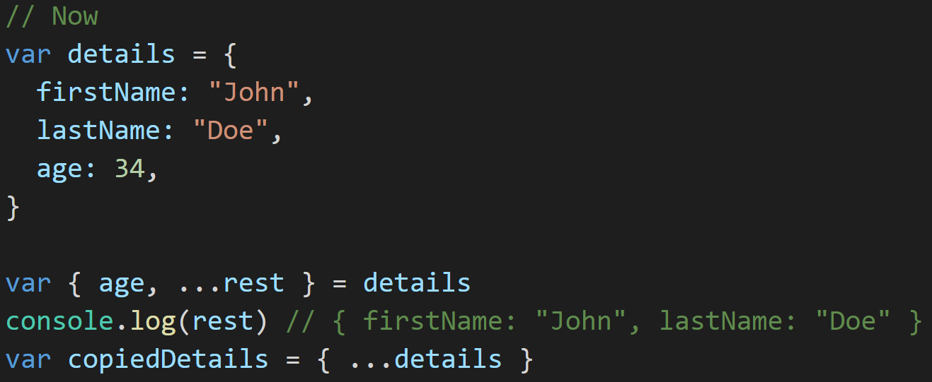
JavaScript basics
15
Rest/Spread operator
Destructuring made even simpler
Notes:
“this” refers to the owner of the function.

Slide 32
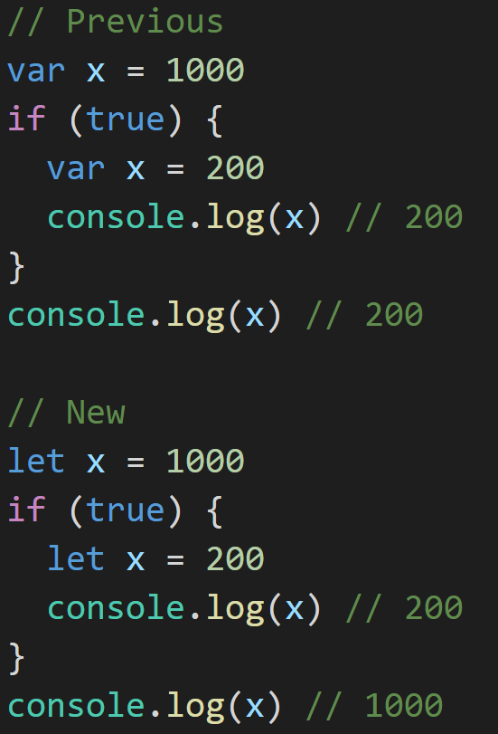
JavaScript basics
16
Block-scoped “let”…
Couples variables with the scope
Notes:
Ponadto przy let i const nie zachodzi hoisting

Slide 33
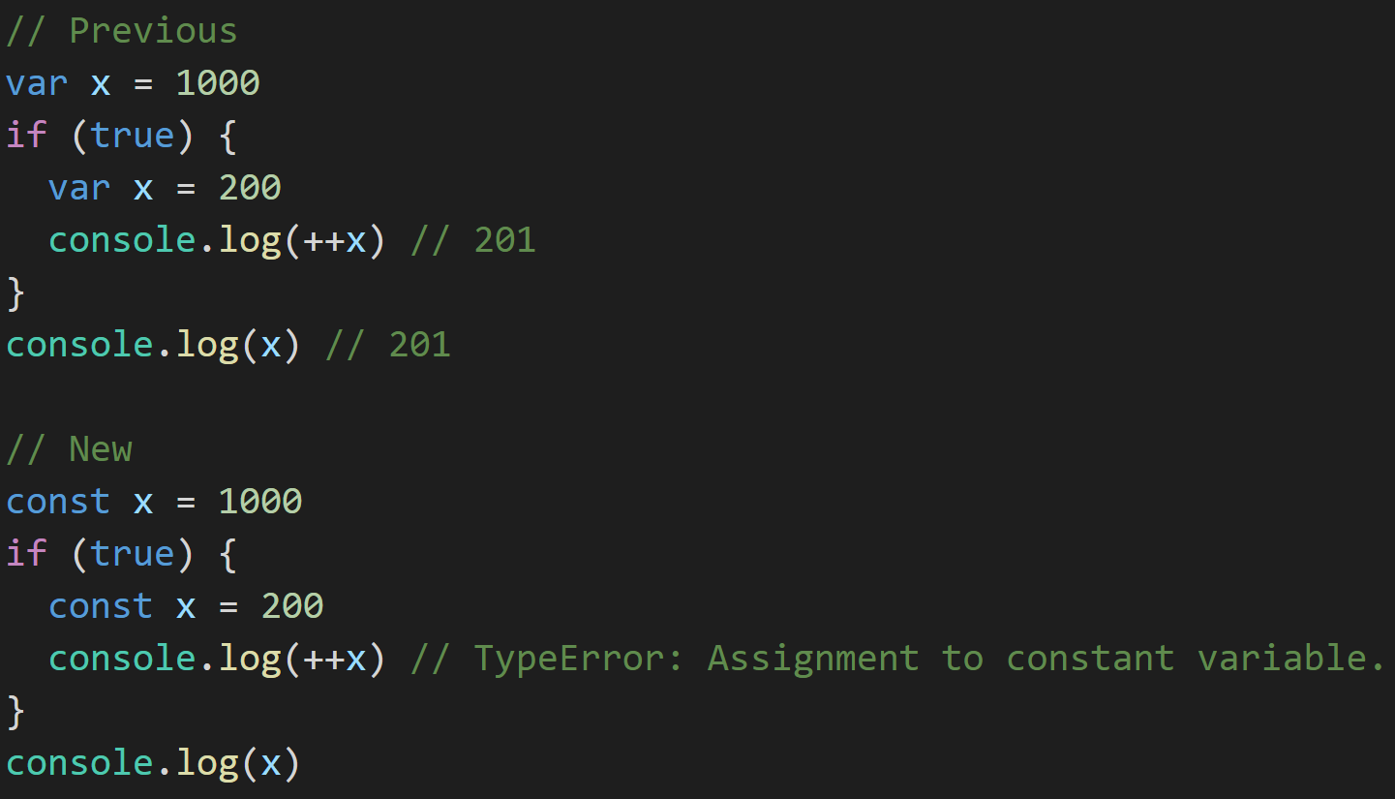
JavaScript basics
17
…and “const”
Disallows reassignments
Notes:
“this” refers to the owner of the function.

Slide 34
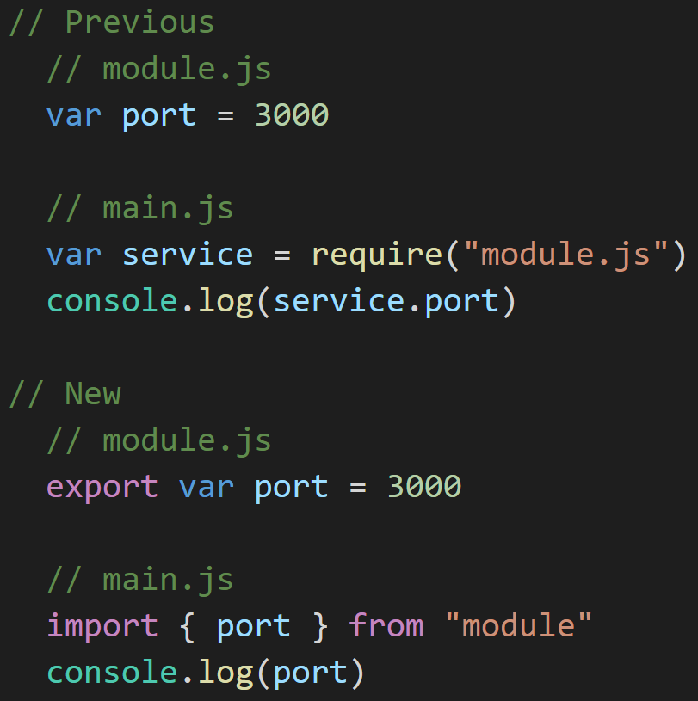
JavaScript basics
18
Modules
Import only what’s really needed
Notes:
Ponadto przy let i const nie zachodzi hoisting

Slide 35
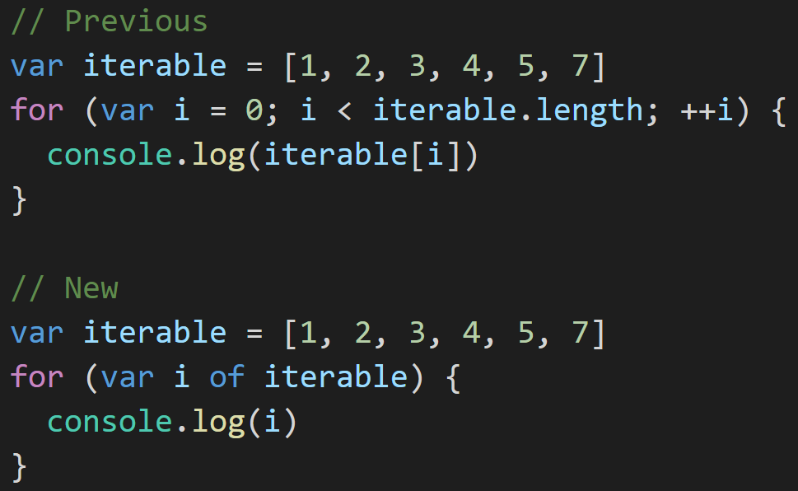
JavaScript basics
19
For-of loops
Because every language has them :)
Notes:
“this” refers to the owner of the function.

Slide 36
Introduction to react.js
1
React.js is not a framework. It is
only a view library.

Slide 37
Introduction to react.js
2
No controllers
No digest loops
No directives
No view models
Just Components.
In react.js world every rendered block is a component.

Slide 38
Introduction to react.js
3
Separation of concerns components
(only) if they are designed and built as self-contained entities.
Composability and flexibility
Reusability
Maintainability
Ability to be tested independently

Slide 39
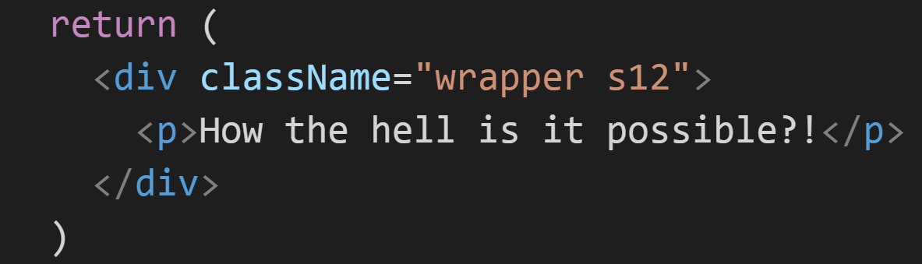
Introduction to react.js
4
JSX
xml-like syntax extension for EcmaScript
HTML!?

Slide 40
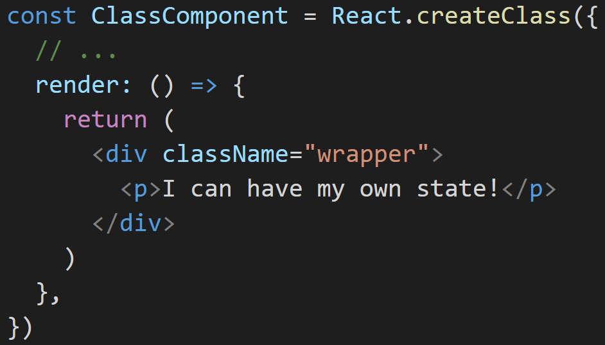
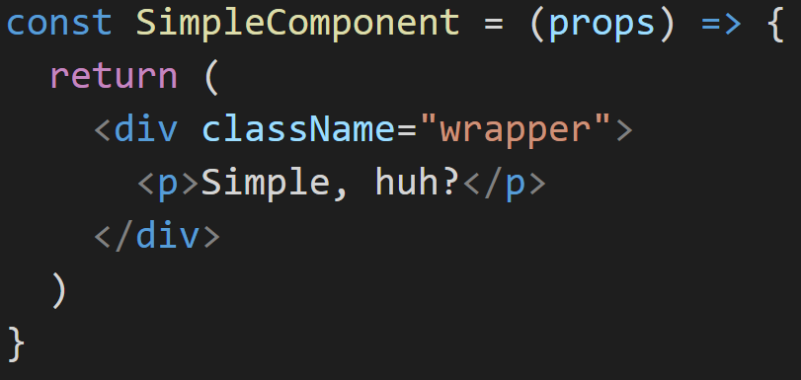
Introduction to react.js
5
Functional components
Class-based components
Define simple and stateless components.
Used for more advanced entities maintaining their own state.

Slide 41
Introduction to react.js
6
Data flow
No library
Angular 2+
react.js
All-to-all
Two-way data binding
One-Way data binding
Any component can communicate directly with any other component.
Compares values representing application state (in all components) before and after browser events.
Model is the single source of truth. More deterministic than two-way binding – side effects are not possible.
Notes:
One way data binding wymusza świadome zmiany stanu; zmiana modelu nie odbywa się „automagicznie”.

Slide 42
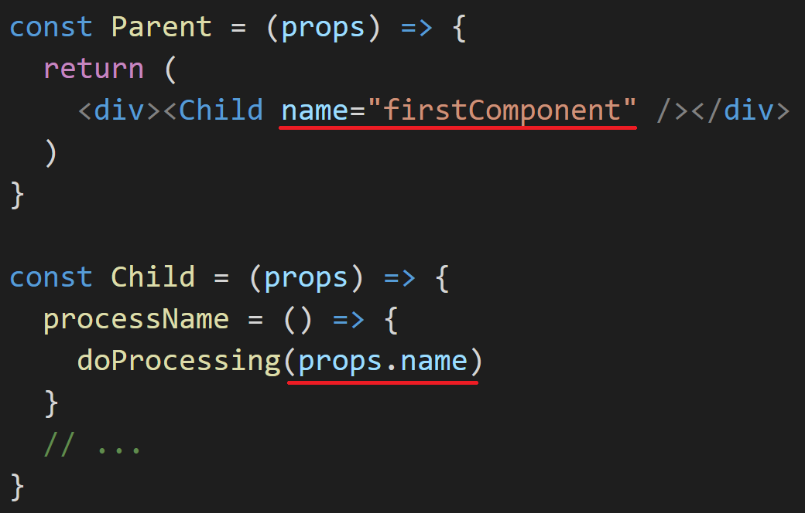
Introduction to react.js
7
Data in child component is accessed via “props” object.
props within children are immutable (cannot be overwritten).

Slide 43
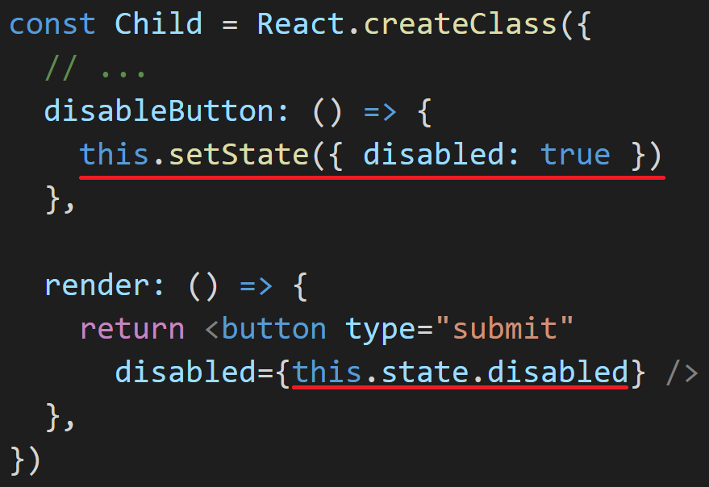
Introduction to react.js
8
Each component can have its own isolated state.
The state can be accessed by its owner only. It can be mutated.
Notes:
Stan komponentu może być dostępowany i modyfikowany wedle ściśle określonych reguł, np. zmiana stanu tylko za pomocą setState()

Slide 44
Introduction to react.js
9
By default react.js rerenders components whenever their props or state change.

Slide 45
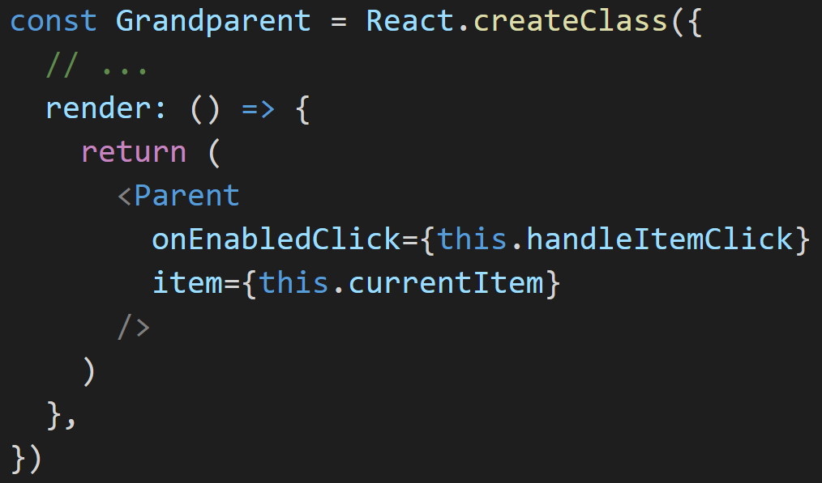
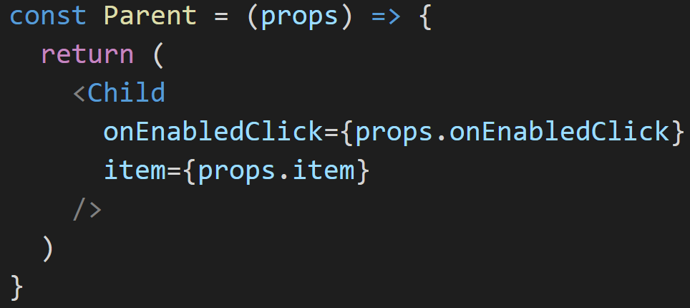
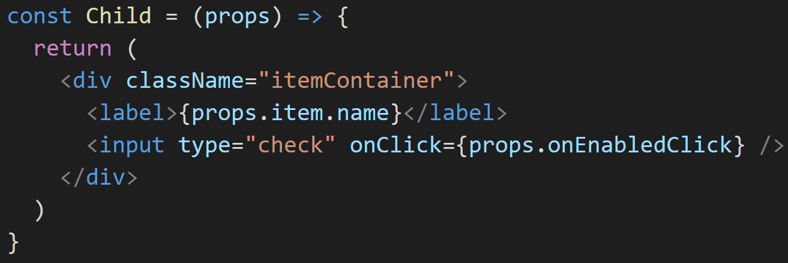
Introduction to react.js
10
Data flows down

Slide 46
Introduction to react.js
10
events flow up

Slide 47
Introduction to react.js
10
Data flows down*
events flow up*

Slide 48
Introduction to react.js
10
Data flows down
events flow up
Just like in DOM.

Slide 49
Introduction to react.js
11
Virtual DOM
Pure JavaScript, in-memory abstraction of real DOM
Whenever render() fires (which means that state or props have been updated), react.js updates the in-memory DOM representation
If anything has changed, react.js modifies the real DOM to match
Notes:
Dwa typy obiektów: ReactElement i ReactComponent. ReactElement to tak naprawdę JSowa nakładka na elementy HTMLowe. Frontend developerzy budują aplikacje reactowe z ReactComponentów. Te mogą posiadać stan, jednak nie mają dostępu do VirtualDOMu. Dlatego podczas rendera są one konwerowane wewnętrznie przez Reacta na obiekty typu ReactElement. Te są od razu wstawiane do VirtualDOMa. Jeżeli coś się zmieniło pomiędzy poprzednim snapshotem a aktualnym stanem, prawdziwy DOM jest uaktualniany.

Slide 50

Introduction to react.js
12
Because performance matters.
Notes:
Dwa typy obiektów: ReactElement i ReactComponent. ReactElement to tak naprawdę JSowa nakładka na elementy HTMLowe. Frontend developerzy budują aplikacje reactowe z ReactComponentów. Te mogą posiadać stan, jednak nie mają dostępu do VirtualDOMu. Dlatego podczas rendera są one konwerowane wewnętrznie przez Reacta na obiekty typu ReactElement. Te są od razu wstawiane do VirtualDOMa. Jeżeli coś się zmieniło pomiędzy poprzednim snapshotem a aktualnym stanem, prawdziwy DOM jest uaktualniany.

Slide 51
Introduction to react.js
13
Hands-on
First react component
source available: 01-react-base

Slide 52
Introduction to react.js
14
Component split
Has to be done based on the application ui design
&
business requirements analysis

Slide 53
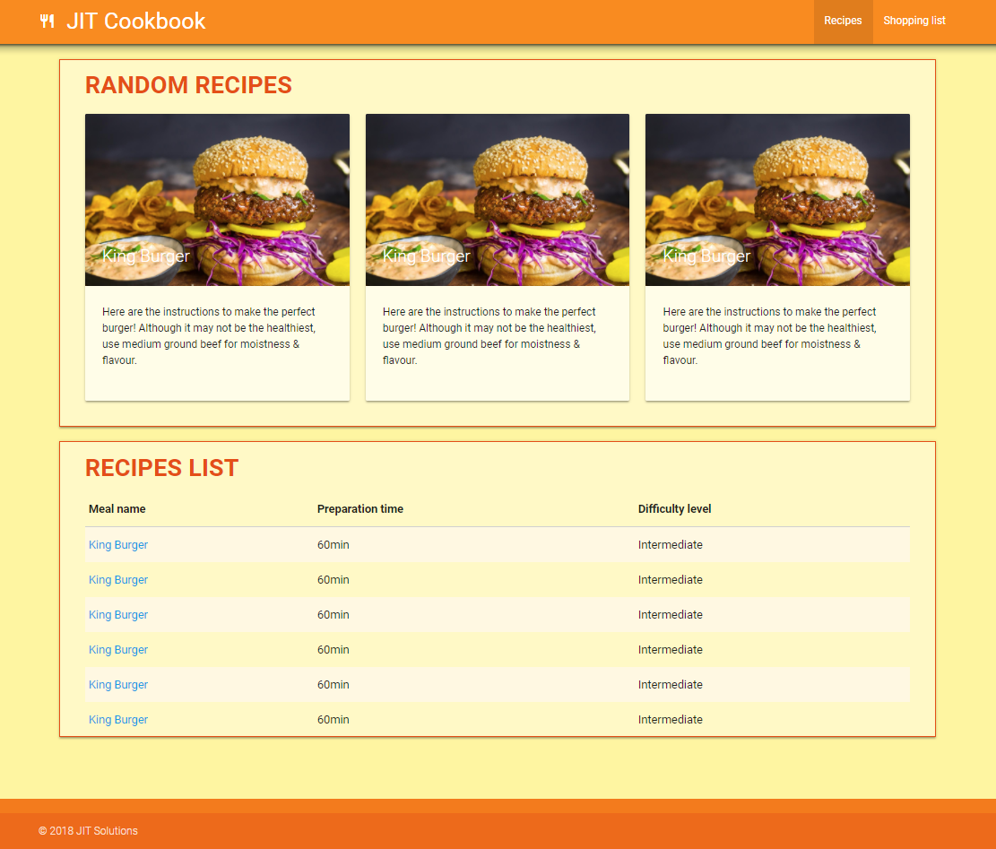
Introduction to react.js
15
JIT Cookbook
Navigation bar at the top should show the application name with icon (left side) and navigation panel between dashboards (right side)
Currently active dashboard tab is indicated with darker color
User should be able to switch between the dashboards by clicking on particular tabs
By default Recipes dashboard should be shown
Footer contains only the copyrights section with company name

Slide 54
Introduction to react.js
15
JIT Cookbook – recipes dashboard
Recipes dashboard’s main screen is responsible for displaying three random recipes in the top panel and full list of recipes in the bottom panel
After clicking on any name from the recipes list, the user should see a single recipe view (the whole page should be replaced with page representing single recipe)
A single recipe view should contain detailed description of the meal and list of ingredients needed in order to prepare it

Slide 55
Introduction to react.js
15
JIT Cookbook – recipes dashboard
Recipes dashboard’s main screen is responsible for displaying three random recipes in the top panel and full list of recipes in the bottom panel
After clicking on any name from the recipes list, the user should see a single recipe view (the whole page should be replaced with page representing single recipe)
A single recipe view should contain detailed description of the meal and list of ingredients needed in order to prepare it

Slide 56
Introduction to react.js
16
Navbar
Content
Footer

Slide 57
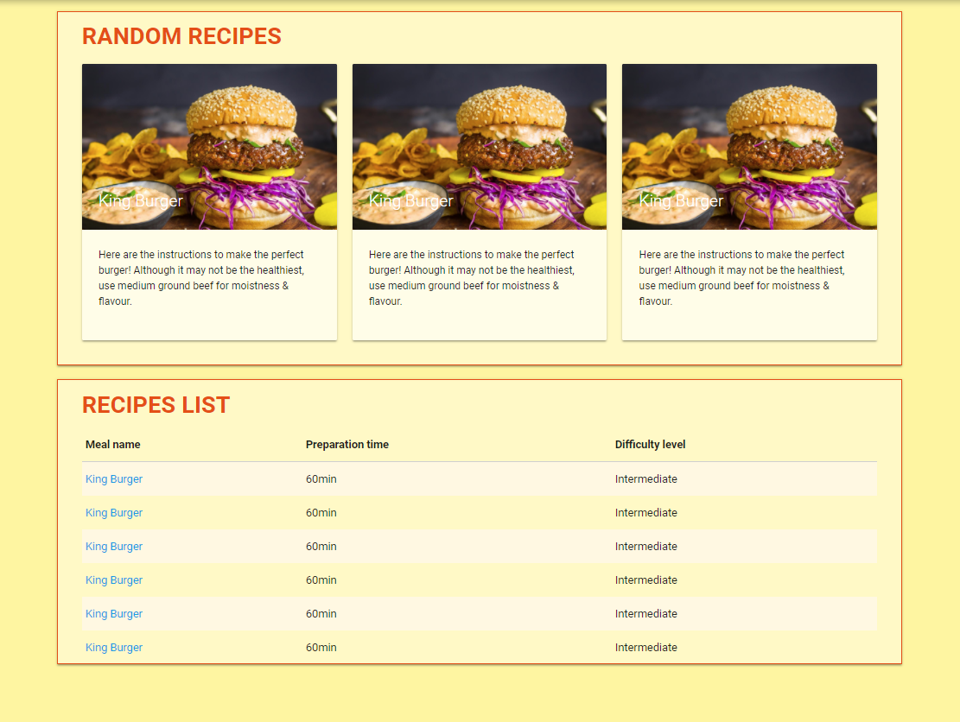
Introduction to react.js
16
RecipesContainer

Slide 58
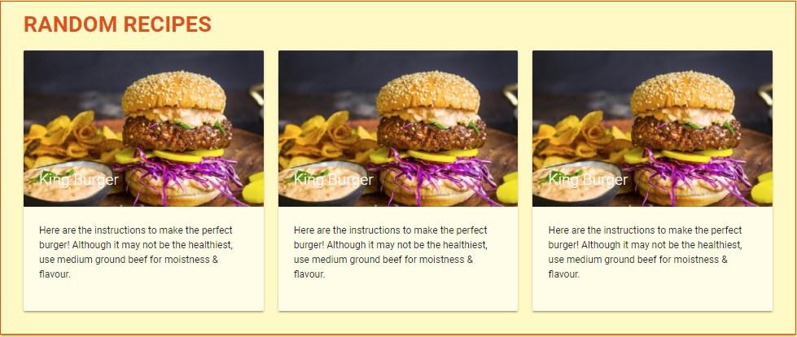

Introduction to react.js
16
RandomRecipesList
RecipeCard

Slide 59
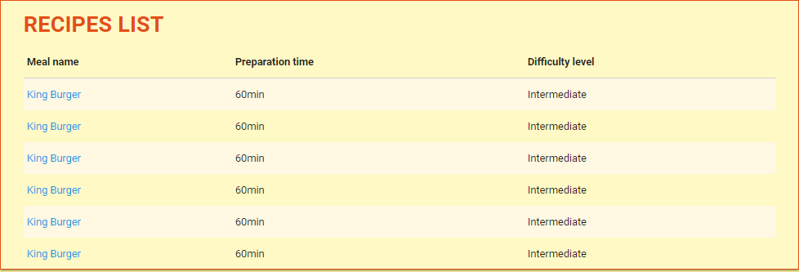
Introduction to react.js
16
RecipesTable
RecipesTableEntry

Slide 60
Introduction to react.js
17
Hands-on
Base component split
source available: 02-react-base-layout

Slide 61
Introduction to react.js
18
PropTypes
When the application grows it’s quite important to ensure that all objects passed to component as props match the desired types
PropTypes is a react.js built-in mechanism to run typechecking
All you have to do is to assign a specific property to a component

Slide 62
Introduction to react.js
19
Hands-on
Props typechecking
(let’s convert some of the components to classes as well)
source available: 03-class-based-components

Slide 63
Introduction to react.js
20
Action binding
Making application interactive!

Slide 64
Introduction to react.js
21
User clicks on tab
Active tab indicator updates
Content component decides
Proper component is rendered

Slide 65
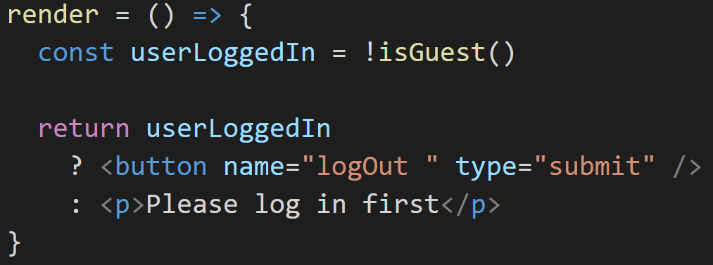
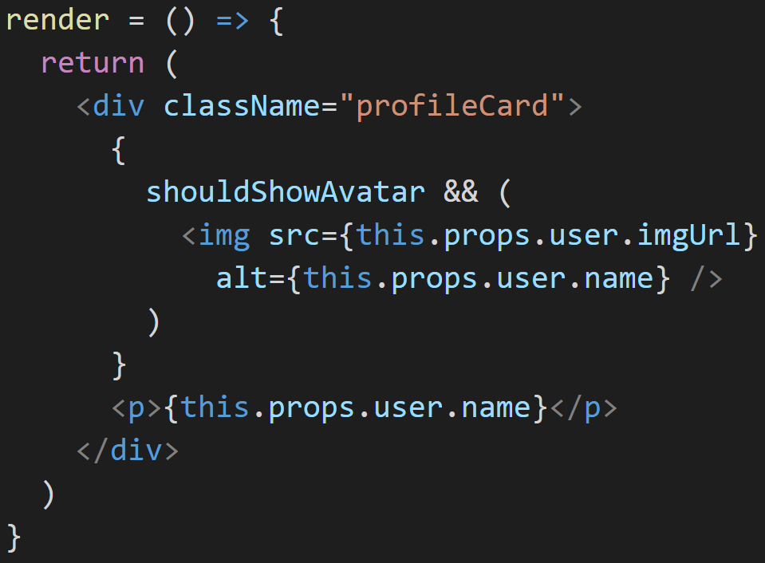
Introduction to react.js
22
Conditional rendering
Decide what to render based on current conditions
Notes:
“this” refers to the owner of the function.

Slide 66
Introduction to react.js
23
Hands-on
Bringing some life to the application
source available: 04-state-action-binding

Slide 67
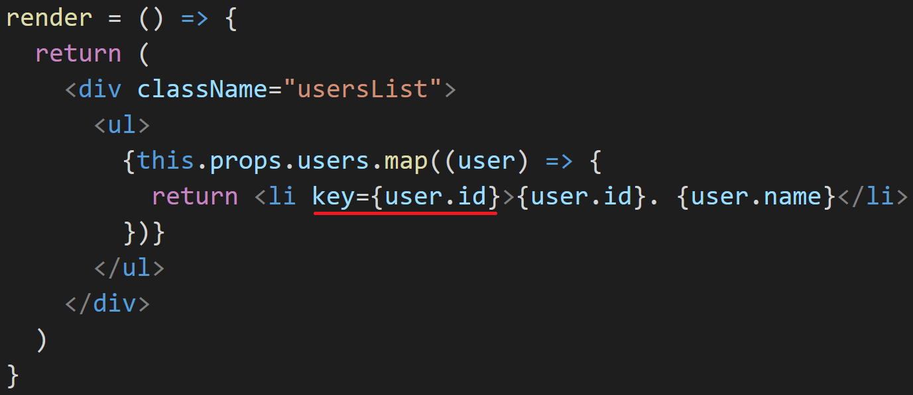
react.js more advanced concepts
1
Lists rendering
“key” property is crucial.
Notes:
Key jest ważne bo pomaga optymalizować zmiany w VirtualDOMie; znowu – performance!

Slide 68
react.js more advanced concepts
2
Component lifecycle
React.js allows us to intercept each phase of components lifecycle
Useful when we want to update component configuration based on the calculation on new props or the difference between new and old ones
Hooks may be necessary when you’re dealing with 3rd party libraries
Notes:
constructor
componentWillMount() – tylko raz (przynajmniej w normalnym mode, dla server-side rendering może być kilka razy), nie ma dostępu do DOMu, prepare for render
render() – metoda musi być pure, nie możemy zmieniać stanu tam (unikanie rekurencji)
componentDidMount() – mamy dostęp do DOM i do elementów-dzieci; potencjalnie może wytriggerować kolejnego rendera
componentWillReceiveProps() – pozwala nam zupdate’ować stan
shouldComponentUpdate() – decyzja czy rerenderować, zwracamy true albo false
componentWillUpdate() – przygotowanie do następnego rendera, nie zmieniamy tu stanu bo znowu możemy skończyć w pętli
componentDidUpdate() – mamy dostęp do poprzednich propsów i stanu; nie powinniśmy zmieniać stanu tutaj też
componentWillUnmount() – garbage collection i ogólnie cleanup

Slide 69
react.js more advanced concepts
3
Hands-on
Enhance lists renderings and inspect lifecycle hooks
source available: 05-list-renderings-and-hooks

Slide 70
react.js more advanced concepts
4
PureComponent
Special type of react.js component. Reduces number of wasted renderings.
Notes:
A jak to robi? No w bardzo prosty sposób. shouldComponentUpdate() dla PureComponentów zwraca wartość głębokiego na jeden poziom porównania poprzednich propsów i state’u z nowymi.

Slide 71
react.js more advanced concepts
5
Hands-on
Optimize number of renderings by inheriting from React.PureComponent
source available: 06-pure-components

